Slide 1
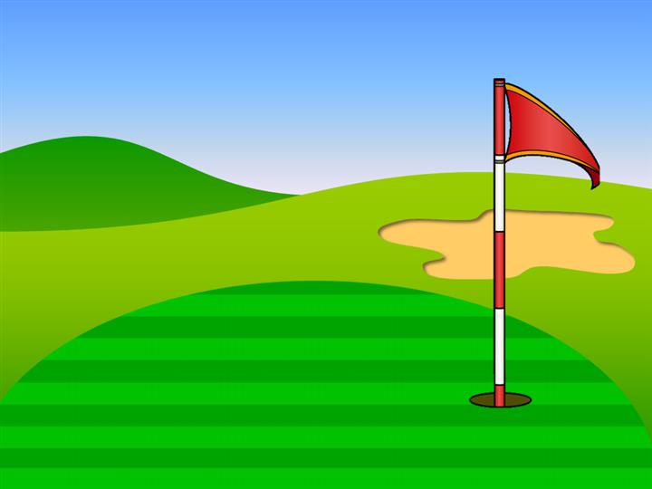

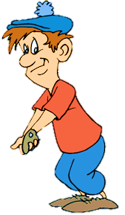
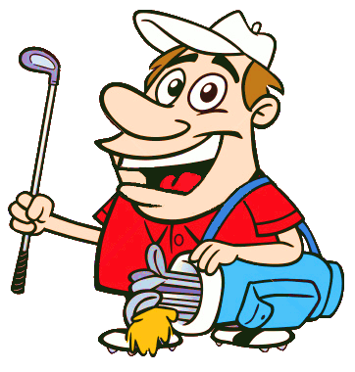




YET - ALREADY

Slide 2
already
The train has ________ left.
1/12
yet
already
NEXT

Slide 3
yet
Have the children had a shower _________?
2/12
yet
already
NEXT

Slide 4
yet
They haven’t visited the city __________.
3/12
yet
already
NEXT

Slide 5
already
He has ________ cooked the meals.
4/12
yet
already
NEXT

Slide 6
yet
We haven’t found our pet ___________.
5/12
yet
already
NEXT

Slide 7
already
She has __________ finished her homework
6/12
yet
already
NEXT

Slide 8
yet
She has _________ to arrive.
7/12
yet
already
NEXT

Slide 9
already
We’ve ________ been to England.
8/12
yet
already
NEXT

Slide 10
already
Everybody has ________ gone home.
9/12
yet
already
NEXT

Slide 11
yet
Have they arrived _________?
10/12
yet
already
NEXT

Slide 12
already
The children have _________ got up.
11/12
yet
already
NEXT

Slide 13
yet
He hasn't repaired the car __________ .
12/12
yet
already
EXIT

