Slide 1
ART TEMPLATE
森林派对可爱通用模板
THIS IS A ART TEMPLATE ,THE TEMPLATE DESIGN BY JIUJIU.
THANK YOU WATCHING THIS ONE.

Slide 2
目 录
02
03
Just for today I will try to live through this day only and not tackle my whole life problem at once Just
Just for today I will try to live through this day only and not tackle my whole life problem at once Just
01
04
Just for today I will try to live through this day only and not tackle my whole life problem at once Just
Just for today I will try to live through this day only and not tackle my whole life problem at once Just

Slide 3
01
此 处 添 加 标 题
THIS IS A ART TEMPLATE ,THE TEMPLATE DESIGN BY JIUJIU. THANK YOU WATCHING THIS ONE.

Slide 4
Just for today I will try to live through this day only and not tackle my whole life problem at once Just for today I will try to live through this day only and not tackle

Slide 5
此处添加标题
Just for today I will try to live through this day only and not tackle my whole life problem at once Just for today I will try to live through
Just for today I will try to live through this day only and not tackle my whole life problem at once Just for today I will try to live through

Slide 6
Just for today I will try to live through this day only and not tackle my whole life problem at once Just for today I will try to live through
Just for today I will try to live through this day only and not tackle my whole life problem at once Just for today I will try to live through
Just for today I will try to live through this day only and not tackle my whole life problem at once Just for today I will try to live through

Slide 7
Just for today I will try to live through this day only and not tackle my whole life problem at once I will try to live through this day only and not tackle my
此处添加标题
Just for today I will try to live through this day only and not tackle my whole life problem at once I will try to live through this day only and not tackle my
Just for today I will try to live through this day only and not tackle my whole life problem at once I will try to live through this day only and not tackle my

Slide 8
此处添加标题
01
Just for today I will try to live through this day only and not tackle my whole life problem at
02
Just for today I will try to live through this day only and not tackle my whole life problem at
03
Just for today I will try to live through this day only and not tackle my whole life problem at
04
Just for today I will try to live through this day only and not tackle my whole life problem at

Slide 9
02
此 处 添 加 标 题
THIS IS A ART TEMPLATE ,THE TEMPLATE DESIGN BY JIUJIU. THANK YOU WATCHING THIS ONE.

Slide 10
Just for today I will try to live through this day only and not tackle my whole life problem at once Just for today I will try to live through this day only and not tackle
Just for today I will try to live through this day only and not tackle my whole life problem at once Just for today I will try to live through this day only and not tackle

Slide 11
此处添加标题
Just for today I will try to live through this day only and not tackle my whole life problem at once Just for today I will try to live through
Just for today I will try to live through this day only and not tackle my whole life problem at once Just for today I will try to live through

Slide 12
Just for today I will try to live through this day only and not tackle my whole life problem at once Just for today I will try to live through
Just for today I will try to live through this day only and not tackle my whole life problem at once Just for today I will try to live through
Just for today I will try to live through this day only and not tackle my whole life problem at once Just for today I will try to live through
Just for today I will try to live through this day only and not tackle my whole life problem at once Just for today I will try to live through

Slide 13
Just for today I will try to live through this day only and not tackle my whole life problem at once Just for today I will try to live through this day only and not tackle
Just for today I will try to live through this day only and not tackle my whole life problem at once Just for today I will try to live through this day only and not tackle

Slide 14
此处添加标题
Just for today I will try to live through this day only and not tackle my whole life problem at once Just for today I will try to live through this day only and not tackle

Slide 15
03
此 处 添 加 标 题
THIS IS A ART TEMPLATE ,THE TEMPLATE DESIGN BY JIUJIU. THANK YOU WATCHING THIS ONE.

Slide 16
此处添加标题
Just for today I will try to live through this day only and not tackle my whole life problem at once Just for today I will try to live through this day only and not tackle

Slide 17
01
02
03
Just for today I will try to live through this day only and not tackle my whole life problem at once
Just for today I will try to live through this day only and not tackle my whole life problem at once
Just for today I will try to live through this day only and not tackle my whole life problem at once

Slide 18
Just for today I will try to live through this day only and not tackle my whole life problem at once Just for today I will try to live through this day only and not tackle
Just for today I will try to live through this day only and not tackle my whole life problem at once Just for today I will try to live through this day only and not tackle
Just for today I will try to live through this day only and not tackle my whole life problem at once Just for today I will try to live through this day only and not tackle

Slide 19
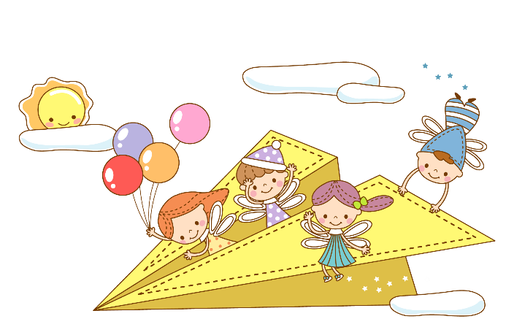
此处添加标题
Just for today I will try to live through this day only and not tackle my whole life problem at once Just for today I will try to live through this day only and not tackle

Slide 20
04
此 处 添 加 标 题
THIS IS A ART TEMPLATE ,THE TEMPLATE DESIGN BY JIUJIU. THANK YOU WATCHING THIS ONE.

Slide 21
此处添加标题
Just for today I will try to live through this day only and not tackle my whole life problem at once Just for today I will try to live through this day only and not tackle

Slide 22
Just for today I will try to live through this day only and not tackle my whole life problem at once I will try to live through this day only and not tackle my
Just for today I will try to live through this day only and not tackle my whole life problem at once I will try to live through this day only and not tackle my

Slide 23
01
Just for today I will try to live through this day only and not tackle my whole life problem at
02
Just for today I will try to live through this day only and not tackle my whole life problem at
03
Just for today I will try to live through this day only and not tackle my whole life problem at

Slide 24
Just for today I will try to live through this day only and not tackle my whole life problem at once Just for today I will try to live through this day only and not tackle
此处添加标题
THIS IS A ART TEMPLATE ,THE TEMPLATE DESIGN BY JIUJIU.
THANK YOU WATCHING THIS ONE.
Just for today I will try to live through this day only and not tackle my whole life problem at once Just for today I will try to live through this day only and not tackle

Slide 25
ART TEMPLATE
非常感谢您的聆听
THIS IS A ART TEMPLATE ,THE TEMPLATE DESIGN BY JIUJIU.
THANK YOU WATCHING THIS ONE.

